Slide 1
Mathematical Approaches to Ensuring Data Privacy: Analyzing Differential Privacy and Cryptographic Techniques
Module Name: Computing Individual Research Project
Module Code: 7151CEM
Title: CW Presentation
Student Name: Thanushri Mekala
Student ID: 14992461

Slide 2
Introduction
In this digital age, businesses have to deal with a lot of data privacy issues because private data is spread around, and they need safe ways to store and process it.
This project focus on analyzing and evaluating mathematical approaches, cryptographic techniques and differential privacy, that can be used to make data safer without losing its value in real-world situations
Notes:
For instance, in recent years say 2019 there was a massive high-profile data breaches which became a reason for improved data security and privacy solutions. Paige Thompson, a former software employee has been accused of breaking into capital one server and gaining access , disclosing millions of people data. Capital One breach which revealed millions of customer’s records due to vulnerabilities in traditional privacy and security methods. [Reference: CNN News article.]

Slide 3
Research Aim
Research Aim:
Analyze and evaluate mathematical approaches, cryptographic techniques, and differential privacy to enhance data privacy.
Importance:
Growing concerns over data breaches demand robust, scalable, and regulatory-compliant privacy solutions.

Slide 4
Research Background & Problem Statement
Challenges in Data Privacy:
Traditional methods (e.g., anonymization) are vulnerable to re-identification attacks.
Trade-off between security, efficiency, and data usability.
Need for scalable privacy-preserving frameworks.
Research Question:
How can differential privacy and cryptographic techniques enhance data security while maintaining usability?

Slide 5
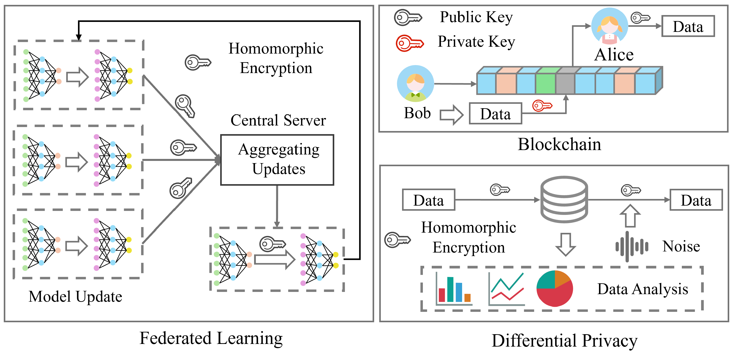
Relevant Existing Studies – Differential Privacy
Differential privacy
Pros:
Provides privacy guarantees.
Well-suited for statistical analysis.
Cons
Affects data accuracy for ML models.
Requires careful parameter consideration.

Slide 6
Relevant Existing Studies – Cryptographic Techniques
Cryptographic Techniques
Pros:
Enables computations on encrypted data
Ensures strong data security
Cons:
Slow
Complex implementation for real time applications

Slide 7
Here is a table representing where differential privacy and cryptographic techniques do not stand together
Aspect | Differential privacy | Cryptographic techniques
Data Protection | DP protects data by adding noise to the data | These techniques encrypts data to protect it from unauthorised access
Mathematical basis | It depends on probability and distribution theory / models E.g. Laplace, Gaussian | Cryptographic techniques rely on encryption algorithms like RSA, and hashing functions
Performance | Decrease in the utility due to additional noise | Even though accuracy increases there is computational overhead
Risk | Proper calibrated noise should be added. Improper noise calibration still leads to sensitive information leakage | Data is fully encrypted to prevent from unauthorized access. One can not extract data without appropriate decryption key. Weak key management or flaws in algorithm can pose risks
Compliance and privacy laws | Designed to meet requirements of GDPR, HIPAA by controlled data release | Supports requirements of PCI-DSS and FIPS through encryption protocols

Slide 8
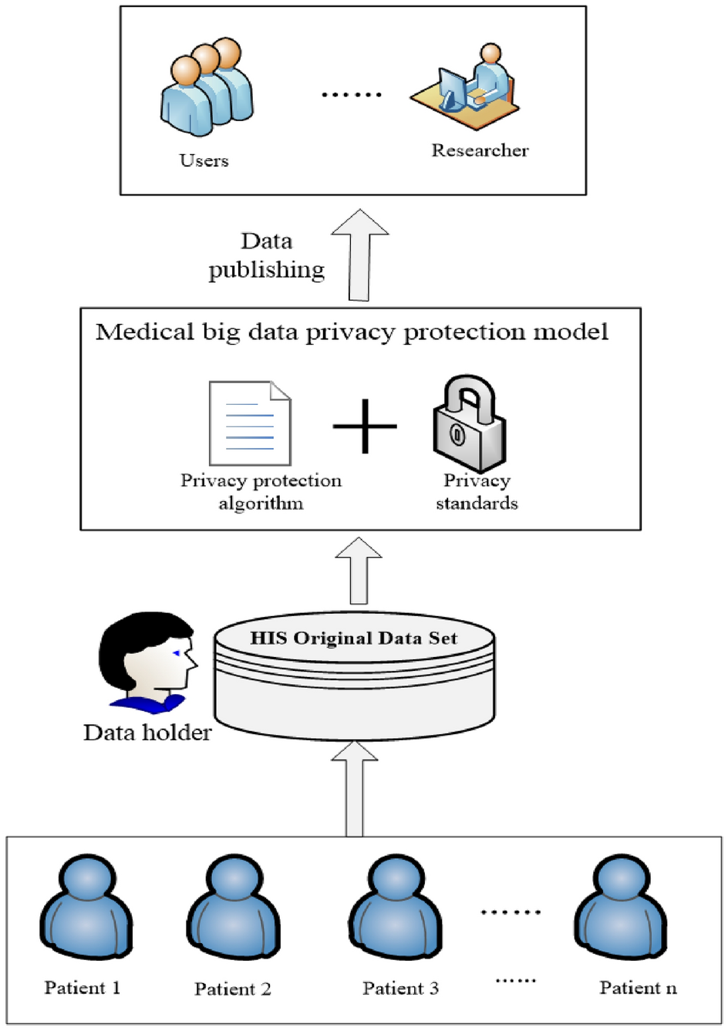
Identified Research Gap
Identified Research Gap:
No single method balances security, efficiency, and usability.
Hybrid approaches need to be explored.
Proposed Solution:
Combine differential privacy and cryptography.
Evaluate effectiveness based on security, computational cost, and data utility.

Slide 9
Research Methodology
Approach:
Theoretical analysis of privacy models and their limitations.
Practical implementation of techniques on real/synthetic datasets.
Evaluation based on privacy strength, accuracy, and computational overhead.
Key Experiment Parameters:
Privacy budgets, cryptographic encryption levels, and runtime performance.
Notes:
This research methodology helps in developing hybrid models combining both techniques which tests on real time data sets and evaluates the performance based on security, computational efficiency and data utility

Slide 10
Implementation & Tools Used
Experiments Conducted:
Applied differential privacy to datasets and tested the impact of noise.
Implemented cryptographic techniques and evaluated computation speed.
Developed a hybrid model to analyze security vs. efficiency trade-offs.
Tools & Frameworks:
Python (PySyft, SmartNoise, PySEAL, TensorFlow Privacy).
Public datasets from healthcare and finance domains.

Slide 11
Research Results & Key Findings
Balancing Privacy & Utility:
Higher privacy leads to lower data accuracy.
Cryptography enhances security but at increased computational cost.
Regulatory Compliance and Industry Impact:
Alignment with GDPR, HIPAA, and other privacy laws.
Usability in healthcare, financial, and AI-driven applications.

Slide 12
Representing the trade offs between efficiency and privacy
Differential privacy offers a balanced approach between efficiency and privacy.
Whereas cryptographic techniques focus majorly on privacy.

Slide 13
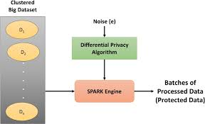
Discussion & Practical Implications
Our research shows that using differential privacy along with encryption methods can make data safer without losing any of its value.
These results give businesses a reason to use data analytics and machine learning tools that protect customer privacy.

Slide 14
Conclusion & Future Work
No single technique is sufficient; hybrid approaches are more effective.
Differential privacy is suitable for analytics, while cryptography is essential for secure data sharing.
Future Research Directions:
Optimize hybrid models for real-time processing.
Explore AI-driven privacy-preserving techniques.
Notes:
Investing in privacy preserving solutions is key to future with high level data security in sensitive industries like health care and finance.

Slide 15
References
Jiang, R., Bouridane, A., Li, C.-T., Crookes, D., Said Boussakta, Hao, F., & Edirisinghe, E. A. (2022). Big Data Privacy and Security in Smart Cities. Springer Nature.
Slepian, P. (2012). Mathematical Foundations of Network Analysis. Springer Science & Business Media.
Aggarwal, C. C., Yu, P. S., & Springerlink (Online Service. (2008). Privacy-Preserving Data Mining : Models and Algorithms. Springer Us
Augustin, T., Fabio Gagliardi Cozman, & Wheeler, G. (2023). Reflections on the Foundations of Probability and Statistics. Springer Nature.
Ruis, A. R., & Lee, S. B. (2021). Advances in quantitative ethnography : second international conference, ICQE 2020, Malibu, CA, USA, February 1-3, 2021 : proceedings. Springer.
Erchin Serpedin, Chen, T., & Rajan, D. (2017). Mathematical Foundations for Signal Processing, Communications, and Networking. CRC Press.

